Slide 1

Team eXi

Slide 2


Current Iteration
Upcoming Meetings
Upcoming Milestones
8
Internal Meetings
8 Oct 2018
Mid Term
8 Oct 2018
11
Supervisor Meetings
2 Oct 2018 –
16 Oct 2018
Client Meetings

Slide 3
Stepping Stones Project
This project aims to deliver a Web Portal as the final product. The Web Portal serves as a management system and communication bridge between the parents, students and Centre.
The Portal provides the Centre with management functionalities such as the creation of user accounts, planning of schedule, management of student details and generation of Financial Reports while allowing for easier data management across the various branches.
On the Customer Relations aspect, the Portal allows for busy parents to keep track of their children’s progress on the go without needing to physically make a trip down to the Centre. The reward system implemented for the students are aimed at motivating them through recognition of their efforts in various areas to achieve better results.

Slide 4


Road Ahead
Acceptance
Poster Submission
17 Aug 2018
29 Oct 2018
Proposal Submission
Mid Term
Final Presentation
20 June 2018
8 Oct 2018
19 Nov 2018 – 27 Nov 2018

Slide 5
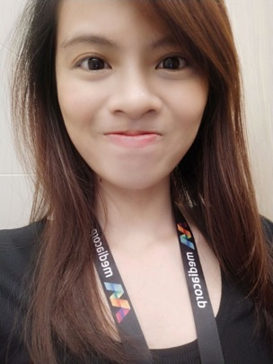

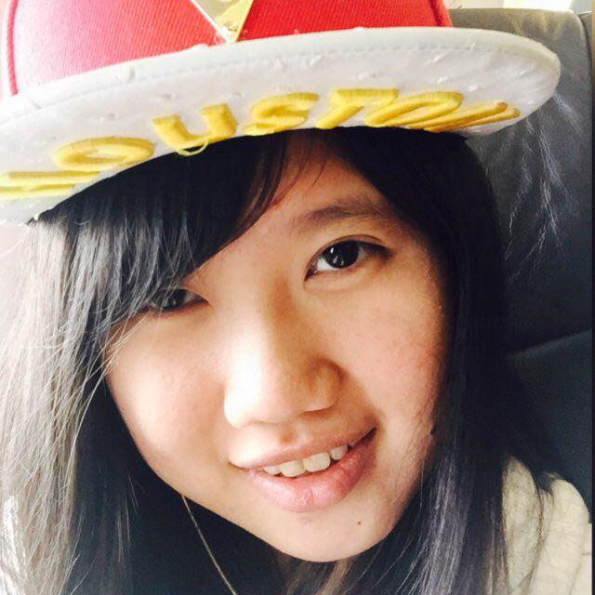

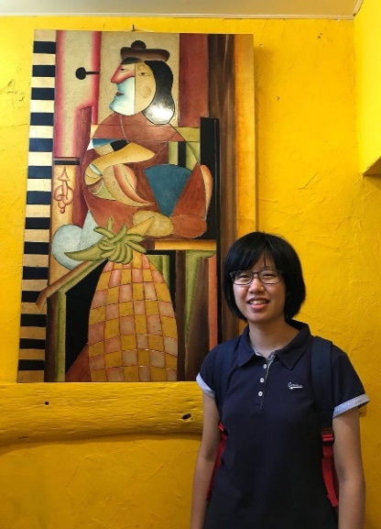
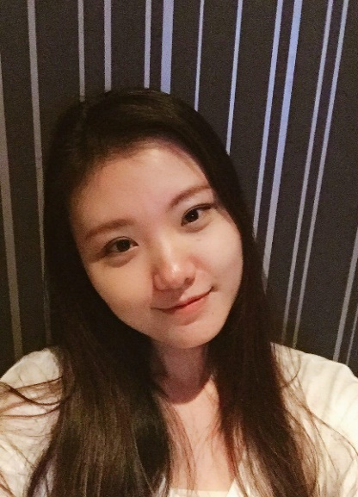
Project Manager
Quality Assurance
Lead Front End Developer
Lead Back End Developer
Back End Developer
Back End Developer
Deputy Front End Developer

Slide 6
Our Project
We will be building an integrated Web Application which aims to support the operations management of the centre and the administrative duties that are to be carried out by the tutors on a daily basis, provide a platform for parents to monitor the performance of their children and to encourage the students to work harder through the implementation of a Reward System.

Slide 7
Schedule Management
Student Management
Attendance Taking
Creation of Curriculum Calendar
Updating of Curriculum Calendar
Assignment of Tutors to lessons
Viewing of Curriculum Calendar
Registration of New Students
Updating of Student Information
Removal of Students from Database
Tracking of Students’ Attendances
Tracking of Tutors’ Attendances
Financial Report Mgmt
Payment Tracking
Creation of Reports
Updating of Reports
Creation & Updating of Expenses
Viewing of Reports
Exporting of Reports
Receipt Generation
Tracking of Payments made
Tracking of Overdue Payments
ePayment (PayNow)
Generation of Receipts in PDF format
Generation of Payslips in PDF format
Dashboard
Grades Tracking
Financial Report Summary
Weekly Lesson Schedule
Classes in need of replacement tutors
Reward
Adding of Grades
Updating of Grades
Viewing of Grades
Allocation of Points
Updating of Points
Tracking of Points
Payment Reminders
Analytics
SMS Reminders for Payment
Students’ performance analysis

Slide 8
Project Motivation
The education sector is an industry in which the team could relate to as students. Upon discussion with the client, the team understands that operational tasks carried out could take up to several hours in total per day due to the Paper-Based System currently implemented. The team recognises that the time allocated to these tasks could be shortened significantly with the implementation of a system and hence gave rise to the idea of this project.
The Team
Project Scope

Slide 9
CORE
SECONDARY
TERTIARY
GOOD-TO-HAVE
Accounts Module
Profile Management
Login/Logout
Reset Password
Schedule Module
Creation of Schedule
Updating of Schedule
Viewing of Schedule
Upcoming Classes
Tutor Assignments
Receipts Module
Pay Slip Generation
Invoice Generation
Grades Module
Grades Modification
Adding of Grades
Grades Viewing
Rewards Module
Creation of reward points
Updating of reward points
Reading of reward points
Search Module
Search Students
Search Tutors
Search Reports (By Month, By Year)
Dashboard Module
Summary of Financial Report
List of Late Payments
List of Classes which needs Replacement
Class Listing (With Class Sizes, Timings)
Weekly Lesson Schedule
No. of Students
No. of Classes
No. of Branches
No. of Tutors
List of Edited Lessons
Reminder Module
SMS Reminders for Payment and Late Payments
Analytics Module
Analysis on student’s performances
Attendance Module
Creation of Tutor & Student Attendance
Reading of Tutor & Student Attendance
Updating of Tutor & Student Attendance
Admin Module
Access Control
User Mgmt
Tutor Mgmt
Branches Mgmt
Subject Mgmt
Parent Mgmt
Student Mgmt
Expenses Module
Creation of Expenses
Updating of Expenses
Deleting of Expenses
Financial Module
Exporting of Financial Report
Updating of Financial Report
Writing of new Financial Report
Viewing of Full Reports
Calculations for expenses. revenue, tutor fees and profits
Payment Module
Payment Tracking
Updating of Payment status
List of Payments made
ePayment (PayNow)

Slide 10
Stakeholders
Sponsor
Users
Adam
Founder of Stepping Stones Learning Centre
Administrative Staff
Tutors
Parents
Students

Slide 11

X Factor
Mid Term
Conduct Pilot Testing with the Centre on 2 classes of 10 students and 1 tutor
Final
Reduction in time taken to complete daily administrative tasks for an estimated of 30 - 40%

Slide 12
Learning Outcomes
With 5 mods including FYP as well as two sports competitions has made me very pressed for time. However, it better taught me how to manage and plan my time. It has also taught me how to better work in a team, not to overpromise deadlines for example.
Through this project I have also improved my coding proficiency and expanded my knowledge on languages.
-Shawn
The role of the Project Manager has made me realise my shortcomings with regards to time management and leadership. I recognized that there are times when the PM has to be firm with her decisions and there are times when the PM has to be flexible with her choices. For me, this ability to make the right call is being honed over the course of this project.
In addition, I am responsible for liaising with the clients and while I was communicating our ideas across to them, I realise the difficulty of expressing myself to them properly. As the time passes by, I got more used to explaining in a way that they could understand and hence I feel that this project has definitely honed my communication skills.
-Hui Xin

Slide 13
As the Lead Front End Developer, I was responsible for designing and implementing an interface that is comfortable for the users, especially considering that our clients are not for sophisticated designs but rather simplicity and practicality. While at times I might have felt that a particular implementation is better, the clients might have other thoughts and that was when I realized that I am not totally placing myself in their shoes. This was a valuable learning experience for me as a Front End Developer
-Moh Moh
As a Back End Developer, I work a lot with coding logic and technical implementations. Certain frameworks or libraries are foreign to me and I have to familarise myself with those technical tools in the shortest time possible due to our tight schedule. Hence, consistent learning throughout development and time management became my key takeaways from this project, aside from all the new technical knowledge.
-Deyu

Slide 14
I have gained experience in understanding and implementing the system based on client's requirement. Most importantly, I was able to learn from experience on working with clients and produce a system that is being use by a real clients.
Besides, as a member of the team, I hope to learn to work as a team, and gain knowledge from the rest of the team while I also share the knowledge I have.
-Riana
I have built on my critical-thinking capability. After meeting the clients, we need to understand client's current business problems so that we can propose solutions that fulfil their real needs.
I have also learnt the importance of planning. Especially when I was having internship which occupant most of my time. Hence the ability to plan properly to complete the tasks assigned to me was extremely important.
-Zang Yu

Slide 15



Buy or Build?
Stepping Stones
Mgmt Charts
Student Data Mgmt
SMS Functionality
Schedule Functionality
Payment Tracking
Attendance Tracking
Student/Parent Portal
Tutor Portal
Tutor Mgmt
Reward System

Slide 16
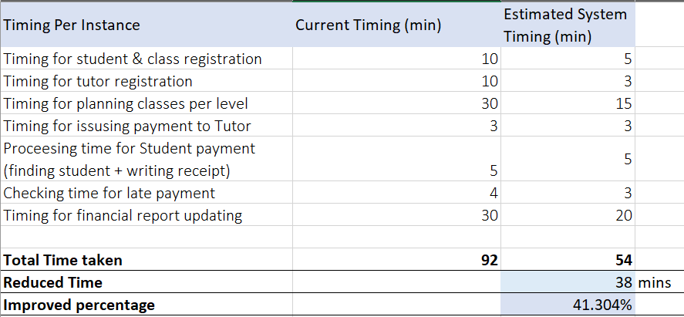
Time Analysis

Slide 17
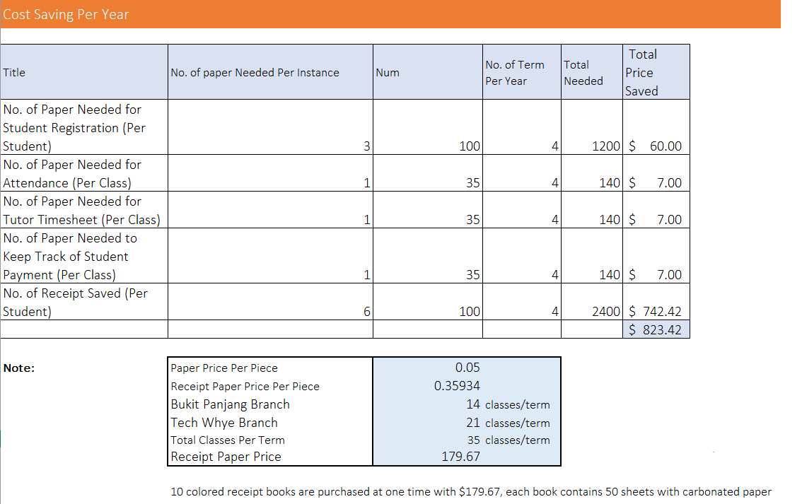
Cost Analysis

Slide 18
Project Schedule
Actual Schedule
Team Meeting Minutes
Client Meeting Minutes
Supervisor Meeting Minutes

Slide 19

Iteration 0
6 Jun – 20 Jun
Iteration 1
21 Jun – 4 Jul
Iteration 2
5 Jul – 19 Jul
Iteration 3
20 Jul – 3 Aug
Iteration 4
4 Aug – 18 Aug
Iteration 5
19 Aug – 2 Sep
Milestone: Proposal Submission
Requirements Gathering
Technical Research
Logo Design
Roles Assignment
Proposal Preparation
Design ER Diagram
Use Case Diagram
Sequence Diagrams
Firebase Database Setup
UI Design
Class Diagram
Accounts Module
Creation of Users entity
Access Control
Profile Mgmt
Login/Logout
Reset Password
Admin Module
CRUD Tutors
Student Mgmt Module
CRUD Students
Classes Module
Creation of Class entity
Grades Module
Grades CRUD
Schedule Module
Creation of Schedule
Supervisor Meeting
User Testing
Milestone: Acceptance
Acceptance Preparation
Schedule Module
Schedule Viewing
Push Notifications for upcoming classes
Financial Report Module
Writing reports using template provided
Updating of reports
Proposed
0
1
2
3
4
5
6
7
8
9
10
11
Iteration 6
3 Sep – 17 Sep
Iteration 7
18 Sep – 2 Oct
Iteration 8
3 Oct – 17 Oct
Iteration 9
18 Oct – 1 Nov
Iteration 10
2 Nov – 16 Nov
Iteration 11
17 Nov – 27 Nov
Financial Report Module
Calculations
Exporting of Reports
Viewing of Reports
Search Module
Search Tutors
Search Students
Search Reports
User Testing
Attendance Taking Module
Push Notifications for Attendance Taking
Financial Report Module
Exporting of reports
User Testing
Milestone: Mid Term
Payment Tracking Module
SMS Reminders for Payments and Late Payments
Attendance Taking Module
Student Attendance Taking
Tutor Attendance Taking
Milestone: Poster Submission
Receipts Module
Receipts for Student Payments
Payslips for Tutors
Payment Tracking Module
Payment Tracking
Supervisor Meeting
Final Presentation Preparation
Dashboard Module
Financial Report Overview
Overdue Payments
Class Information
User Testing
Milestone: Final Presentation
Final Presentation Preparation
UI Enhancement
Supervisor Meeting

Slide 20
Risk Assessment
Likelihood
Low
Medium
High
High
B
A
A
High
C
B
A
High
C
C
B
Impact
‘A’ Risks
Requires the most attention and most well developed mitigation plans
There is a possibility of occurring but it deserves the least amount of planning
‘C’ Risks

Slide 21
Risk Statement
Consequences
Likelihood
Level
Impact
Mitigation Plan
Project Management Risk
Clients are not technology savvy
Situations in which clients attempt to communicate their requirements but were misunderstood by the team
Product might not match client’s needs
Additional time would be spent on reconstructing already completed functionalities
Significant delay in project progress
High
Medium
A
Frequent User Testing
Involve the client throughout the project to receive consistent feedback
Technical Risk
Team is unfamiliar with the development and deployment environments (Jelastic Cloud)
Team might not get used to the languages involved (Javascript, CSS)
More time would be required to complete a functionality
Significant delay in project progress considering the scale of our scope
High
Low
B
Finalise system architecture before commencement of project
Have a more experienced member working with another member for the same functionality
Familarise ourselves with the technical tools and environments that are to be implemented before development starts

Slide 22
Project Management Risk
Majority of the teams would be taking 5 mods along side FYP
Majority of the teams would be on internship in the earlier iterations
Difficult to locate a common timeslot due to the hectic schedules of each individual member
Difficulty in completing tasks on time especially in iterations 8 and 9 when it is the Mid Terms period
Significant delay in project progress which could result in difficulty completing the project on time
High
Medium
A
Have the members consistently list out their exam dates and the PM to allocate tasks and plan the schedule accommodating these dates
Have 2 members working on one functionality to spread the workload
Progress Updates every iteration to ensure that everyone is clear about all functionalities to ensure that there would be someone to take over should there require immediate attention
Client Management Risk
Continuously changing client requirements
Inflating Project Scope
Situations in which we need to reconstruct completed functionalities to accommodate the new requirements
Significant delay in project progress
High
High
A
Lay out detailed project schedule for overview of the capacity the team is working at
Have the client understand that not all requests can be fulfilled
Prioritise and complete the important functions before moving on to the value adding functionalities

Slide 23
Task Metric
Score
Action
TM < 0.5
Understand the root cause and take action immediately
Consult supervisor on next course of action
0.5 < TM <= 0.9
Re-estimate tasks for future iterations
Consume buffer days
Analyse cause of delay and adjust schedule appropriately
0.9 < TM <= 1.1
Roughly on track and to proceed as planned
1.1 < TM <= 1.5
Gross over-estimated effort required
Re-estimate tasks for future iterations
Add number of days gained to buffer days
1.5 < TM
Understand the root cause and take action immediately
Consult supervisor on next course of action

Slide 25
Iter 1
Iter 2
Iter 3
Iter 4
Iter 5
Iter 6
Iter 7
Actual Tasks
14
28
26
27
21
22
23
Planned Tasks
17
30
27
29
23
24
24
Metric Value
0.82353
0.93333
0.96296
0.93103
0.93104
0.91667
0.95833

Slide 26
Bug Metrics
Score
Description
Low Impact – 1 point
Unimportant
Typo error or small User Interface Misalignments
High Impact – 5 points
System runs
Some non-critical functionalities are not working
Critical Impact – 10 points
System down or unusable after a short period of time
Bugs need to be fixed to continue
Total Points
1 x No. of Low Impact bugs + 5 x No. of High Impact bugs + 10 x No. of Critical bugs

Slide 27
Task Metrics
Actual Tasks completed / Estimated Tasks planned

Slide 28
Bug Metrics
Mitigation Plan
BM <= 5
Fix during buffer time only
5 < BM < 10
Use the planned debugging time
BM >= 10
Stop current development and resolve the bug immediately. Project Manager to reschedule the project.

Slide 31
Iter 1
Iter 2
Iter 3
Iter 4
Iter 5
Iter 6
Iter 7
No. of Bugs
0
6
2
5
6
7
11
Low Impact Bugs
0
2
0
5
4
5
3
High Impact Bugs
0
4
2
0
0
2
5
Critical Bugs
0
0
0
0
1
0
3
Metrics Value
0
22
32
37
52
66
124

Slide 32


Primary Persona
Edwin Tan is a 29 years old Master Administrator of Stepping Stones Learning Centre. He has been working with the Centre for 3 years. Being a meticulous and patient individual, Edwin Tan has been dutifully managing the duties across both branches. However, Edwin Tan finds himself needing to manually keep track and sourcing of the Branch Administrator’s information which brings him much inconvenience while carrying out his duties. Edwin hopes to have a system in place to reduce the number of documents to update and look through for a single piece of information.
Jim Lim is a 25 years old Branch Administrator of Stepping Stones Learning Centre, Bukit Panjang Branch. He has been working with the Centre for 2 years. Being an ambitious individual, Jim Lim has always been interested in improving the operations of the Centre. However, Edwin Tan finds himself dedicating a huge amount of time to administrative tasks such as retrieving and updating student information. There are times when Jim makes mistake due to the hectic schedule that he is undergoing and the need to update several documents for just one single piece of information. Jim hopes to be able to retrieve and update necessary information using the shortest time span possible so that he could focus his efforts on more value adding tasks.

Slide 33

Stacy Kim is a 27 years old English Tutor of Stepping Stones Learning Centre. She has been working with the Centre for 2 years. Being a friendly and competent tutor, Stacy has many classes and students under her belt. However, Stacy faces difficulty in remembering to take attendances, especially during days when she has back-to-back classes. In addition, there are students who take multiple subjects under her and hence she finds herself updating the grades for a single student in multiple pieces of paper. The Centre pays Stacy in the form of cash and hence Stacy finds it tough to keep track of her own income. Hence, Stacy hopes to be able to update various grades of a single student at one go, keep track of her pay days and amount received and have reminders for classes so that she would not miss attendance taking when she has a busy day.

Slide 34


Secondary Persona
Mrs Jane Goh is a 34 years old working parent of Jennie. Mrs Goh is an executive in a renowned bank. Being a competent and ambitious working lady, Mrs Goh finds it difficult to keep track of Jennie’s progress in her studies because of her hectic schedules. While Mrs Goh is concerned about Jennie’s performance, she does not have the luxury of time to personally visit the Centre and have a talk with Ms Stacy to understand Jennie’s progress. Hence, Mrs Goh hopes to be able to track Jennie’s performance without the need for constant communication or visits to the Centre.
Jennie Goh is a 12 years old English and Math student of Stepping Stones Learning Centre, Bukit Panjang Branch. She has been with the Centre for almost 1 year to date. Known as a mischievous and unmotivated student, Jennie has always received feedback from teachers that she was being a difficult student. However, Jennie actually wants to work hard yet she finds it difficult to gain motivation for study due to the fact that she feels that her efforts are not recognised simply because of her poor grades. Hence, Jennie hopes to be rewarded and recognised for her efforts in studying, not just through improvements in grades.

Slide 35
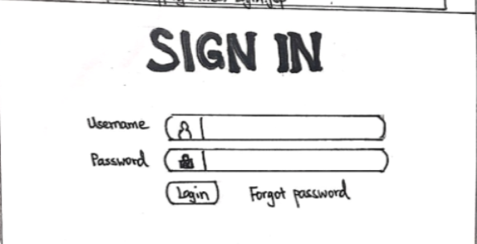
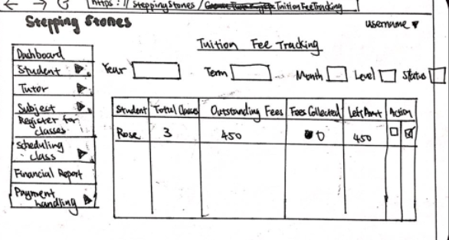
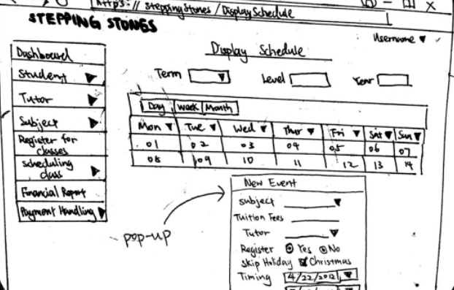
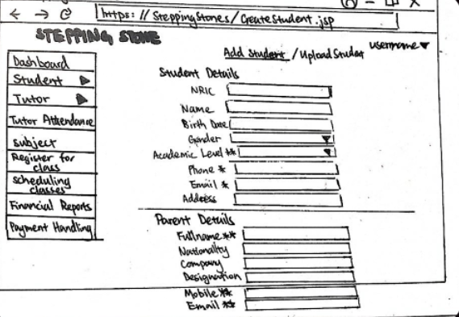
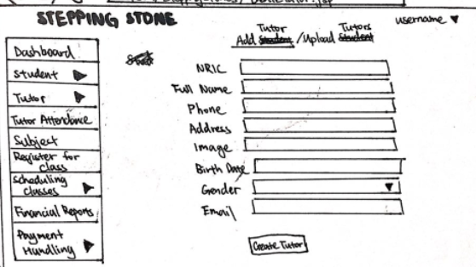
Sketches
Login
Payment Tracking
Scheduling
Student Registration
Tutor Registration

Slide 36
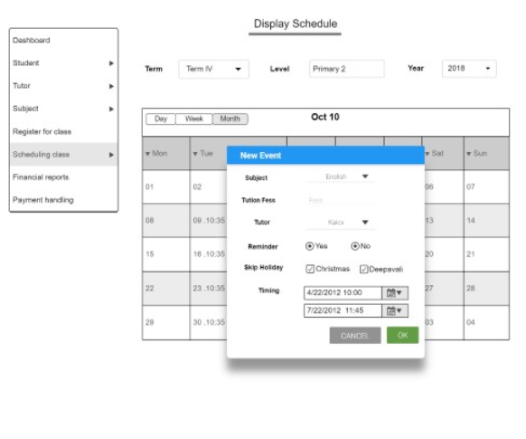
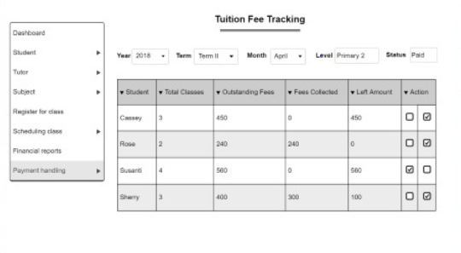
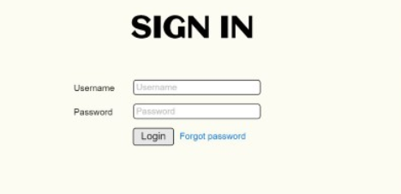
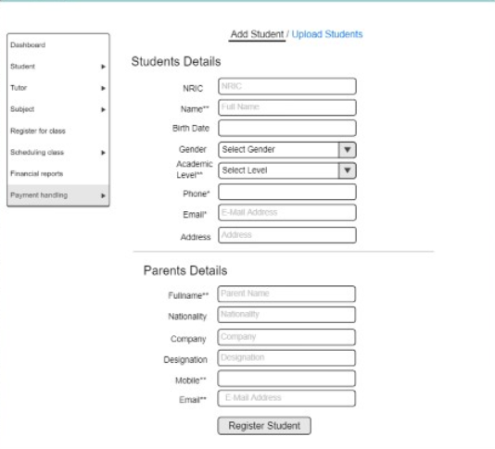
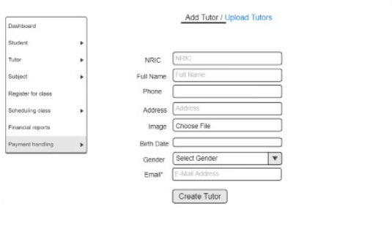
Prototypes
Login
Payment Tracking
Scheduling
Student Registration
Tutor Registration

Slide 37
Test Plan
Objectives
Venue: Stepping Stones Learning Centre, Bukit
Panjang Branch
Date: 28 July 2018, Saturday
Time: 2:30pm – 3:30pm
Number of Participants: 2
Gather feedback regarding UI Design & Navigation Flow
Gauge user’s comfortability & satisfaction with the UI and functionalities implemented
Improve the Portal based on feedbacks and comments received
Test Scope
Account Module
Admin Module
Student Mgmt Module
Grades Module

Slide 38
Results of User Testing
The participants were presented with the Portal while the team members gave them a series of activities to be completed. While they were attempting the activities, they were asked for feedbacks and opinions on the efficiency, satisfaction and comfortability of completing the said activity. At the end of the testing, participants were also asked to comment on the overall usability of the Portal. The team would be implementing the changes gathered from the opinions of the participants.

Slide 39
S/N
Activity
Result
1
Able to login without the guidance of the facilitators using the assigned username and password
Pass
2
Able to navigate to Tutor Creation
Faced a bit of difficulty due to the naming of navigation bars
3
Able to successfully create a Tutor record
Pass
4
Able to successfully edit a Tutor record
Pass
5
Able to navigate to Student Creation
Faced a bit of difficulty due to the naming of navigation bars
6
Able to successfully create a Student record
Pass
7
Able to successfully edit a Student record
Pass
8
Able to successfully add a Student’s grades
Pass

Slide 40
Overall Feedbacks
Function
Comments
Changes
Navigation Bar
Better naming of navigation bars
Change ‘Create Tutors’ to ‘Create Tutor Records’
User Interface
Font size is too small, making it hard for the participants to see
Increase the font size of the Portal
Tutor & Student Creation
Would prefer to be prompted immediately when making mistakes
Live Validation while filling up the form
User Interface
Prefer to have an overview of all information
Implementation of Dashboard as the Home Page
User Mgmt
Prefer to include the parents and students as users
Added parent and student users with their functionalities into the project scope

Slide 41
Test Plan
Objectives
Venue: Stepping Stones Learning Centre, Bukit
Panjang Branch
Date: 8 September 2018, Saturday
Time: 2:30pm – 3:30pm
Number of Participants: 2
Gather feedback regarding UI Design & Navigation Flow
Gauge user’s comfortability & satisfaction with the UI and functionalities implemented
Improve the Portal based on feedbacks and comments received
Test Scope
Attendance Module
Grades Module
Schedule Module

Slide 42
S/N
Activity
Result
1
Able to navigate to the Students Attendance Taking page
Pass
2
Able to navigate to mark an attendance of a student
Faced a bit of difficulty as the layout of the interface was not intuitive enough
3
Able to view the attendance of the students
Pass
4
Able to successfully add a grade for a specific student
A bit confused due to the label specifying grade but input field limited to raw score
5
Able to successfully update the grade for a specific student
Pass
6
Able to navigate to the Attendance Taking page for tutors
Pass
7
Able to navigate to mark the attendance of a specific tutor
Faced a bit of difficulty as the layout of the interface was not intuitive enough
8
Able to view attendance of the tutors
Pass
9
Able to view the curriculum schedule of the year
Pass
10
Able to successfully create an instance of a class using the Schedule functionality
Pass

Slide 43
Overall Feedbacks
Function
Comments
Changes
Attendance Taking
Would prefer to have an overview of a student’s attendance records
Added in an overall % attendance of students
Attendance Taking
Feels that the layout of Attendance Taking functionality is not intuitive
Changed the interface to a table format for easier referencing and consolidation of data
Grades Tracking
Input of grades to be changed to Raw Score / Max Score
Adjusted the input fields for Grades Tracking
Student Mgmt
Prefer to minimize manual inputs by automatically updating the student’s level for a new year
To implement an auto promotion functionality
Scheduling
Prefer to give tutors the right to edit the lesson date but both the original and altered dates has to be displayed
Have a field in the lightbox for tutors to edit the lesson dates

Slide 44
Test Plan
Objectives
Venue: Stepping Stones Learning Centre, Bukit
Panjang Branch
Date: 22 September 2018, Saturday
Time: 2:30pm – 5:00pm
Number of Participants: 2
Gather feedback regarding UI Design & Navigation Flow
Gauge user’s comfortability & satisfaction with the UI and functionalities implemented
Improve the Portal based on feedbacks and comments received
Test Scope
Admin Module
Attendance Module
Grades Module
Schedule Module

Slide 45
S/N
Activity
Result
1
Able to login using the Master Admin account and create a Branch record
Pass
2
Able to navigate to the Create Branch Admin page and create a new Branch Admin record
Pass
3
Able to navigate to the Display Admin page and view the information of all Branch Admins
Pass
4
Able to access the Subject Mgmt functionalities by accessing the Branch Admin account
Participants were a bit confused as to what happens after the creation of Branch Admins
5
Able to navigate to the Create Subject page to create a new subject
Pass
6
Able to navigate to the Display Subjects page and view the information of all Tutors
Pass
7
Able to navigate to the Edit Subject functionality and remove levels from the subject
Could not remove multiple levels at once
8
Able to remove and delete a Subject record
Pass
9
Able to navigate to the Tutor Mass Upload page to upload a csv consisting of all Tutor details
Pass
10
Able to navigate to the Display Tutors page and view the information of all Tutors
Pass
11
Able to navigate to the Edit Tutor functionality and edit the information of a specific tutor
Participants seem to be unable to locate the Edit Tutor functionality

Slide 46
12
Able to navigate to the Tutor Hourly Rate page and add in an hourly rate for the newly created Tutor
Pass
13
Able to navigate to the Tutor Attendance Taking page and mark the attendance for a specific Tutor
Pass
14
Able to navigate to the Student Mass Upload page to upload a csv consisting of all Student details
Pass
15
Able to navigate to the Display Students page and view the information of all students
Pass
16
Able to navigate to the Edit Student functionality and edit the information of a specific students
Participants seem to be unable to locate the Edit Student functionality
17
Able to navigate to the Student Attendance Taking page and mark the attendance for a specific tutor
Pass
18
Able to navigate to the Admin Schedule page and create a new class
Pass
19
Able to edit an existing class with new information
Pass
20
Able to assign a tutor to an existing class
Pass
21
Able to delete a lesson from the Schedule
Pass
22
Able to navigate to the Grades page and update the grades of a specific student
Pass

Slide 47
Overall Feedbacks
Function
Comments
Changes
Attendance Taking
Would prefer to have an option to indicate that the student is absent
To add in an ‘Absent’ button alongside the current ‘Present’ button
Subject Mgmt
Would prefer to be able to remove multiple levels instead of having to open the modal box every single time
Implement ajax instead to remove the level while remaining on the page
Grades Tracking
Prefer to have a % improvement of student’s grades for easier comparison
Have a separate page which analyses the student’s performance and put them in visualizations to aid the teachers in keeping track of student performances
User Interface
Font size is still a bit small and its hard to see
To increase the font size used throughout the User Interface
Tutor & Student Registration
Additional mandatory fields for the registration forms – Qualification, School & Stream
To add in the requested fields into the respective forms
Display Branch Admin
Prefer to remove the restriction of only one Branch Admin per branch
To remove the restriction set
Display Branch Admin
Prefer to have the ability to edit and remove Branch Admin information
To implement Edit and Delete Branch Admin functionalities

Slide 48
COMING SOON
Team eXi

Slide 49












Architecture Diagram
Interface Layer
Admin
HTTP Request
Tutors
HTTP Response
Students
Application Layer
Parents

Slide 50
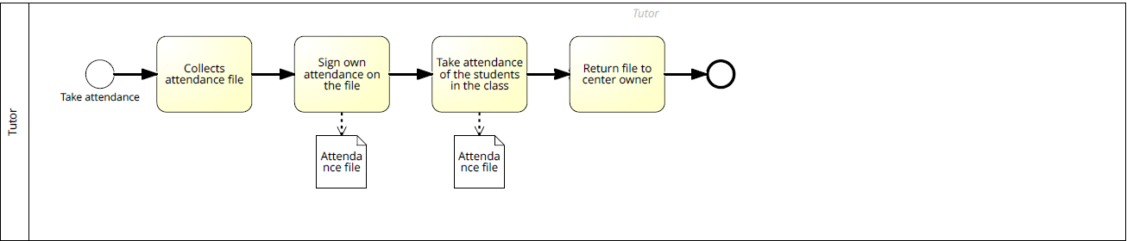
Attendance Taking
As-Is

Slide 51
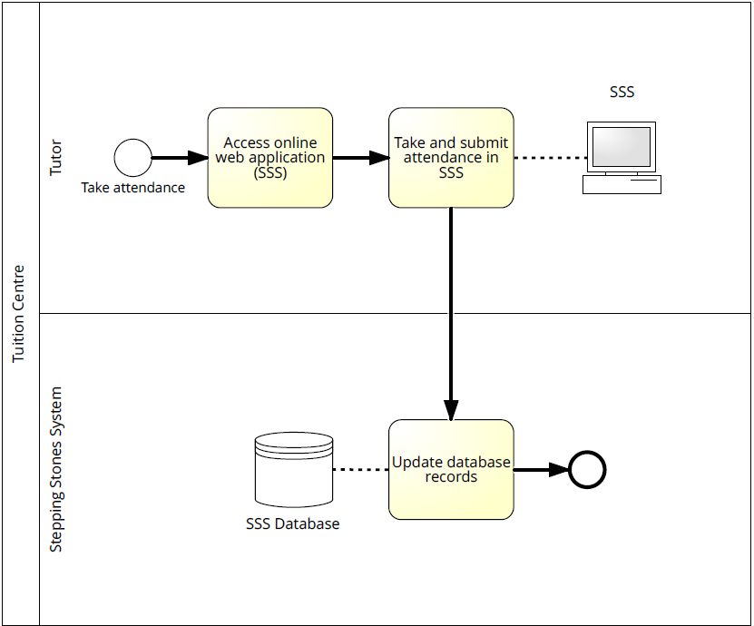
To-Be

Slide 52
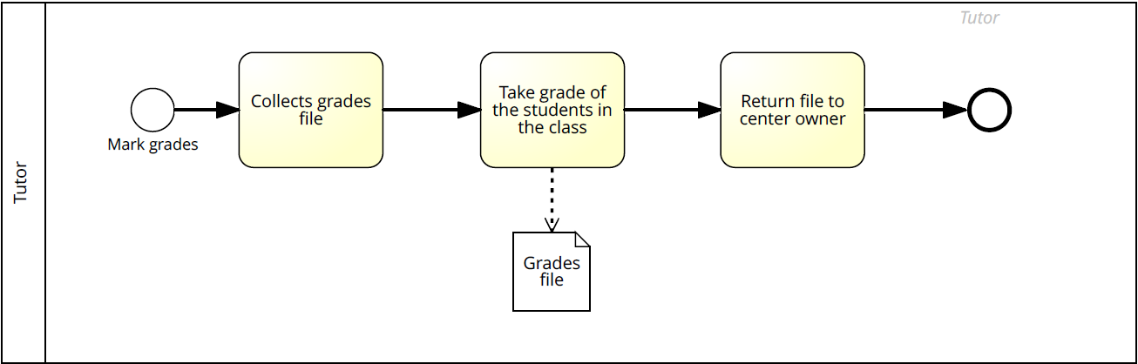
Grades Tracking
As-Is

Slide 53
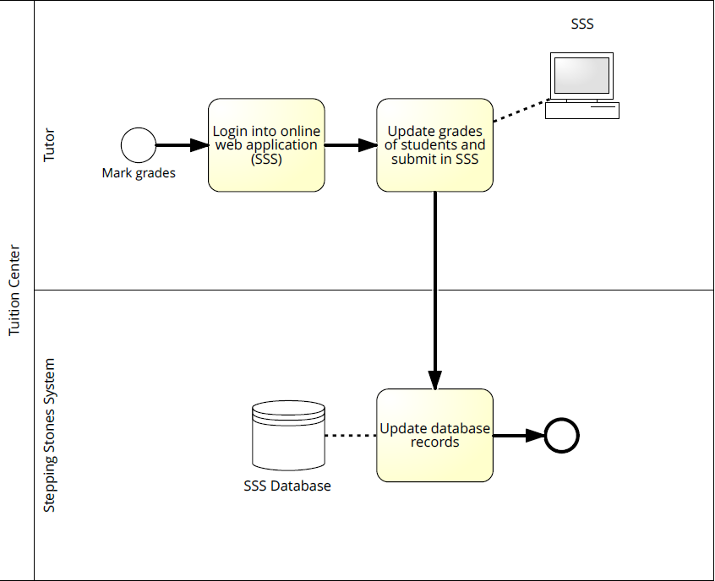
To-Be

Slide 54
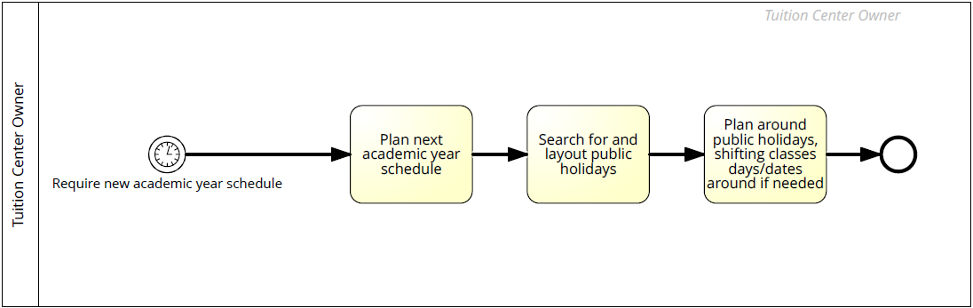
Schedule Creation
As-Is

Slide 55
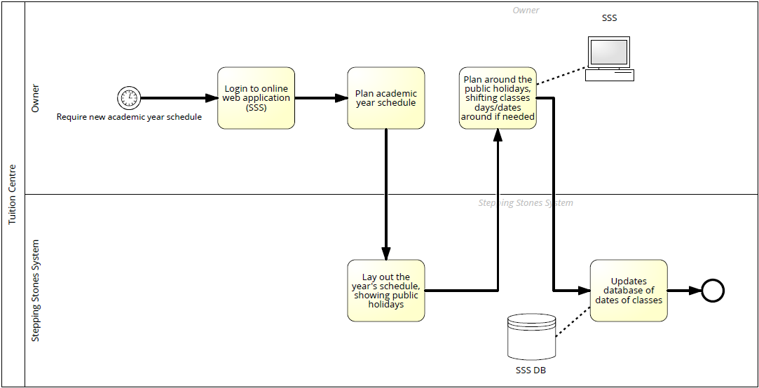
To-Be

Slide 56
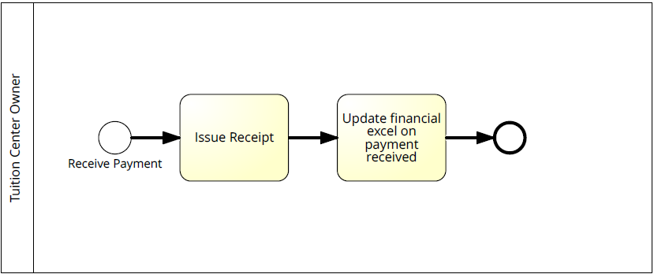
Student Payment
As-Is

Slide 57
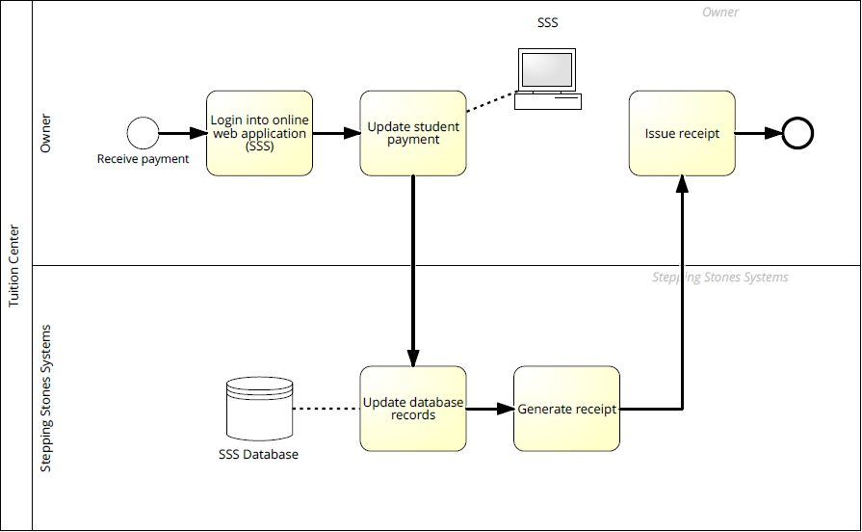
To-Be

Slide 58
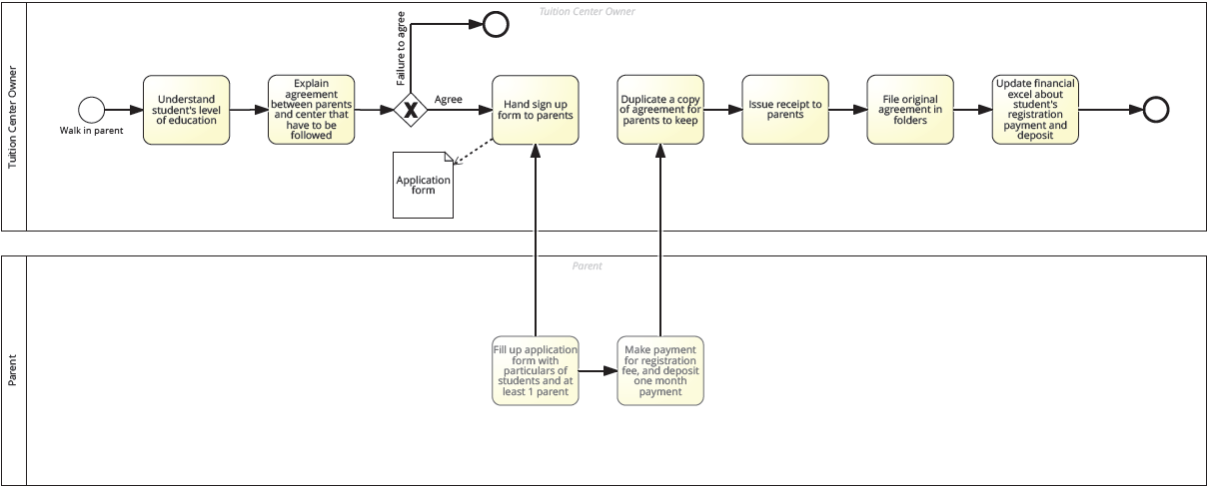
Student Sign Up
As-Is

Slide 59
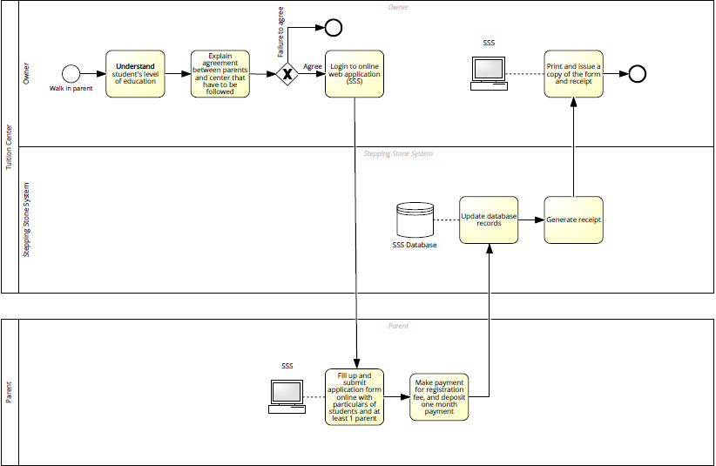
To-Be

Slide 60
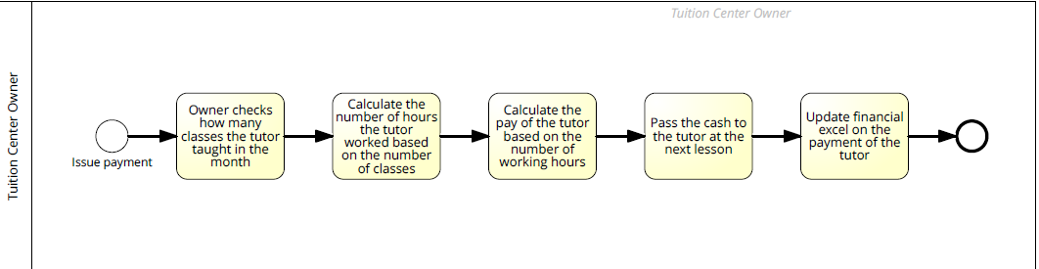
Tutor Payment
As-Is

Slide 61
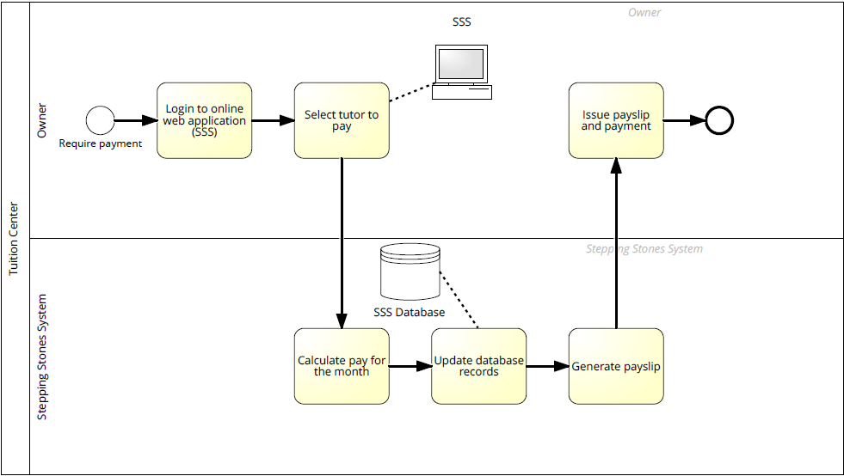
To-Be

Slide 62
Scenario
Edwin has the intentions of opening up a new branch in Yew Tee. After he has settled the location and staff for the new branch. Edwin proceeds to create a new Branch Record in the Portal and imports all the relevant staff details into the Portal. No longer has he need to migrate the necessary information one by one and that has saved him so much time!

Slide 63
Mrs Goh is feeling really worried these days because Timmy is not performing well in school and the teacher has already feedbacked multiple times regarding Timmy’s difficulty in catching up with the class and the lack of motivation from Timmy to achieve better results. After much consideration, Mrs Goh has decided to visit the tuition centre, Stepping Stones Learning Centre, recommended by her friends in their neighbourhood area to seek help in improving Timmy’s academic results. Upon entering the Centre, Mrs Goh was greeted welcomingly by Jim, the Branch Administrator of the Bukit Panjang branch. Mrs Goh and Jim proceeds to have a discussion over Timmy’s needs. Through the discussion, Mrs Goh understands that the Centre has a platform for parents to keep track of the students’ progress and this is what Mrs Goh is looking for! Being a working lady, Mrs Goh has to juggle both work and family life and often finds it tough to keep an eye on Timmy’s progress. With the Portal, Mrs Goh could retrieve Timmy’s results on the go and that would save her a lot of time and effort! Upon agreeing on the classes that Timmy would be enrolled in, Jim explained the agreement that would have to be uphold between the Centre and Mrs Goh and proceed to enter the particulars of Timmy into the Portal. Upon successful sign up, Mrs Goh proceeds to make her payment which Jim then generates a receipt for Mrs Goh. While generating the receipt, the Financial Report gets updated and the Payment Tracking gets updated. Jim no longer has to update multiple documents separately!

Slide 64
Timmy knows that he is not performing as well in school. He puts in a lot of effort but his efforts does not seem to get recognized because his results are not showing drastic improvements. After a period of time, Timmy gets demoralized and has decided that since his efforts does not show, why should he put in so much effort? However, Mrs Goh was really concerned about his academic standing and hence suggest that they could visit the tuition centre in their neighborhood. Timmy was reluctant to the idea of tuition but could not refute his mother’s request and hence the both of them proceeded to Stepping Stones Learning Centre. Upon meeting Jim, Timmy understands that there is a reward system implemented in Stepping Stones Learning Centre and learns that rewards are not just awarded based on academic improvements but other factors as well. As a child, Timmy gets really excited over the possibility of gifts and hence was delighted to give the centre a try. He vows to study hard and redeem as many gifts as possible from the centre!

Slide 65
Due to the school examinations closing by, Ms Stacy has been really busy reviewing her students’ assignments and grading the Centre test papers while preparing for lesson materials. In the past, she often gets so busy that she would forget to take attendances for the classes. However, with the implementation of the Portal, Ms Stacy would be reminded of it when she visits the dashboard upon her login into the Portal and she never has to forget about attendance taking again! Timmy is currently taking English and Mathematics in the Centre under Ms Stacy, when the results are released, Ms Stacy would simply retrieve Timmy from the student list and proceeds to update his results accordingly. No longer would she have to flip through stacks of papers to find the particular grades sheet for Timmy!

Slide 66
Change Management
Change requests initiated by stakeholders
Define extent of change & estimate resources required
Determine priority and impact of change request
Accept or reject the request
Update Change Management Log
Inform stakeholders of accepted change request
Accept
Plan for implementation of change requested
Inform stakeholders of the rejection and rationale behind the rejection

Slide 67
The team would be accessing the changes requested by our stakeholders using the above guidelines in order to better plan and manage our project progress. The impact of the request would be determined by mainly the scale of the request which would be gauged by the estimated time taken to complete the request. We would have to ensure that the change request would not significantly delay the progress of our project. Another factor affecting the impact would be the priority of the request which would be affected by the functionality the change concerns and whether the change would affect our upcoming plans for the project.

Slide 68
Iteration
Date
Type
Change Reason
Description
Issued By
Decision
Action Taken
Request Status
3
29 Jul 2018
Scope
Sponsor had concerns regarding after maintenance of mobile application
The Sponsor was worried that maintenance for the mobile application proposed would be difficult and hence preferred a mobile friendly version of the Portal instead
Sponsor
Considering the fast changing technology standards for iOS apps and possible costs incurred for maintenance issues, the team has decided to drop the iOS application and instead opt for a mobile friendly version of the Portal
Restructure the project scope to remove the mobile application modules and incorporate the new mobile friendly interface, shifting the functionalities found on the mobile application to the Web Portal. There would be a need to replan the schedule as well
Closed
3
29 Jul 2018
Backend Structure
Confidentiality of information to be stored in database
The team recognizes that the information and data stored in the Portal is highly confidential and hence the team hopes to implement the Portal on a more secure server. After much consideration, the team has decided on Jelastic Cloud as the deployment platform due to its cost effective pricing model and security features.
Team
After taking into account the nature of the Portal, the Sponsor has decided to adopt Jelastic Cloud as the deployment platform.
Move the deployment to Jelastic Cloud and set up the project configurations to suit the deployment environment.
Closed

Slide 69
3
29 Jul 2018
Scope
For motivational purposes and to provide a competitive advantage to the Centre
The Sponsor has plans to expand their Centre’s operations and they believe that through constant engagement of the parents and students, it could give them a competitive advantage and would also be able to help the parents and students in keeping track of the students’ performances under the Centre.
Sponsor
Considering that the functionalities to be implemented for the Students and Parents Portal are largely similar to already implemented functionalities, the team believes that it could be achieved with little effort and would not result in significant delay in project progress. Hence, the team has decided to adopt the change.
Restructure the project scope to include the newly added functionalities and to replan the schedule to address higher priority functionalities to avoid delay in project progress
Closed
3
30 Jul 2018
Scope
To increase efficiency for administrative tasks
The Sponsor would like to implement a card system for their students to accumulate points and take attendance through the scanning of cards.
Sponsor
Considering the technical capabilities of the team and the timeline of the project, the team has decided to reject the requested changes as we are unfamiliar with the integration between the hardware device and Portal and could result in significant delay in project progress should we decide to implement the functionality.
Inform the Sponsor of the rejection
Closed

Slide 70

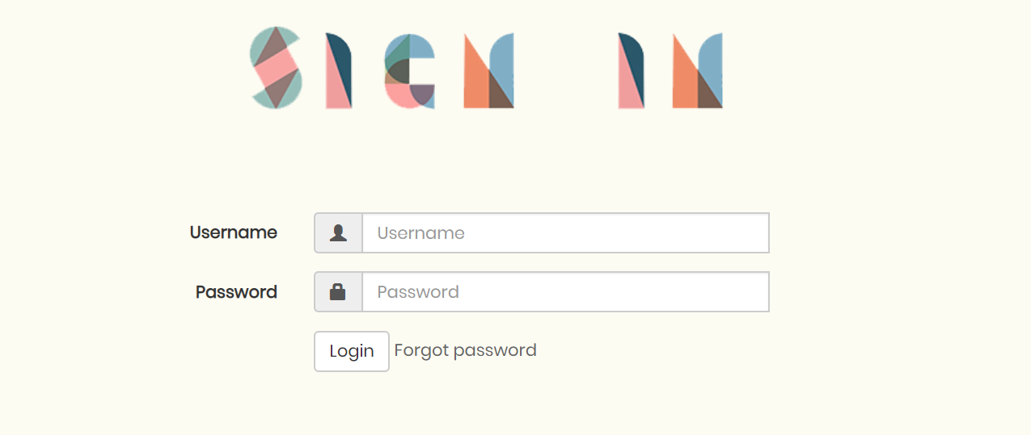
Mid Terms
Project Progress Summary
Iterations Completed
Iteration 8 / 11
~ 73%
Module Completed
~ 51%
Completion Confidence
100%
Click here to view our Mid Term Slides!
Click here to visit the Portal!

Slide 71
Project Milestones
Proposal Submission
20 Jun 2018
Mid Term
8 Oct 2018
Final
19 Nov – 27 Nov 2018
Acceptance
18 Aug 2018
Poster Submission
29 Oct 2018

Slide 72





Project Highlights
Started on Pilot Testing with the Sponsors
Added Grades Analytics Module
Decision to implement PayNow
Modified SMS Reminders to be a standalone module
Added more information to be displayed on Dashboard

Slide 73
Project Status
Functionality
Current Status
Confidence
Comments
Accounts Module
Deployed & Tested, Currently in Pilot Testing
1
-
Admin Module
Deployed & Tested, Currently in Pilot Testing
1
Reliability of email sending has to be investigated
Student Mgmt Module
Deployed & Tested, Currently in Pilot Testing
1
Modifications to be made to the interface for Student Registration
Attendance Taking Module
Deployed & Tested, Currently in Pilot Testing
1
-
Schedule Module
Deployed & Tested, Currently in Pilot Testing
1
Reconstructing of business logic to address corner cases mentioned by Sponsor
Grades Module
Deployed & Tested, Currently in Pilot Testing
1
-
Financial Module
Completed
1
More testing to be done before deployment
Payment Module
75% Completed
1
PayNow to be implemented
Dashboard Module
40% Completed
1
More information to be added to the Dashboard
Expenses Module
In Progress
1
-
Receipts Module
In Progress
1
-

Slide 74
Functionality
Current Status
Confidence
Comments
Rewards Module
In Progress
1
-
Search Module
To Be Implemented
0.9
-
Reminder Module
In Progress
0.9
-
Analytics Module
To Be Implemented
0.7
-

Slide 75
Project Schedule
This section shows the changes we have made to our project schedule since Acceptance.

Slide 76
Iteration 0
6 Jun – 20 Jun
Iteration 1
21 Jun – 4 Jul
Iteration 2
5 Jul – 19 Jul
Iteration 3
20 Jul – 3 Aug
Iteration 4
4 Aug – 17 Aug
Iteration 5
18 Aug – 1 Sep
Milestone: Proposal Submission
Requirements Gathering
Technical Research
Logo Design
Roles Assignment
Proposal Preparation
Design ER Diagram
Use Case Diagram
Sequence Diagrams
Firebase Database Setup
UI Design
Class Diagram
Wiki Update
Wiki Update
Test Cases Design
Accounts Module
Creation of Entity Classes
Firebase Configurations
Home Page
Login/Logout
Reset Password
Admin Module
Tutor Mgmt
Student Registration
Updating of Student Information
Wiki Update
Test Cases Design
Architecture Diagram
Process Diagrams (As-Is & To-Be)
ConnectionManager
Conversion of DAO to call API
Classes Module
Creation of Class entity
Grades Module
Grades CRUD
Supervisor Meeting
Sponsor Meeting
User Testing
Milestone: Acceptance
Acceptance Preparation
Wiki Update
Test Cases Design
Accounts Module
Login Authentication
Email for Password Reset
Dashboard Module
No. of students
No. of tutors
No. of branches
No. of classes
Schedule Module
Classes CRUD
Admin Module
Subject CRUD
Admin CRUD
Branch CRUD
Student Class Registration
Grades Module
Grades CRUD
User Testing
Supervisor Meeting
Wiki Update
Test Cases Design
View Details for all
Schedule Module
Restructuring of Creation & Update
Payment Tracking Module
Payment SMS Reminders
Attendance Taking Module
Students & Tutors Attendance Taking
Supervisor Meeting
Mid Term
0
1
2
3
4
5
6
7
8
9
10
11
Iteration 6
2 Sep – 16 Sep
Iteration 7
17 Sep – 1 Oct
Iteration 8
2 Oct – 16 Oct
Iteration 9
17 Oct – 31 Oct
Iteration 10
1 Nov – 15 Nov
Iteration 11
16 Nov – 27 Nov
Wiki Update
Test Cases Design
Low Fid Wireframe
Schedule Module
Admin Scheduling UI
Tutor Scheduling UI
Grades Module
Grades Interface
Attendance Taking Module
Attendance Taking UI
Admin Module
Student Registration UI
Admin Module
Tutor Registration UI
User Testing
Sponsor Meeting
Supervisor Meeting
Mid Term Preparation
Wiki Update
Test Cases Design
Schedule Module
Admin Scheduling UI
Admin Module
Subject Deleting
Student & Tutor Registration UI
Grades Module
Display Grades UI
Payment Tracking Module
Student & Tutor Payment Tracking
Payment status update
Attendance Taking Module
Attendance Taking UI
User Testing
Supervisor Meeting
Sponsor Meeting
Milestone: Mid Term
Wiki Update
Test Cases Design
Receipt Module
Receipt Generation
Payslips Generation
Expenses Module
Expenses UI
Expenses CRUD
Financial Report Module
Scheduler for Report Generation
Store reports in Jelastic
Dashboard Module
Changes to lesson dates by Tutor
Attendance Taking Module
View Attendances (Student & Parent)
Grades Module
View Grades (Student & Parent)
User Testing
Milestone: Poster Submission
Wiki Update
Test Cases Design
Poster Preparation
Payment Tracking Module
ePayment - PayNow
Search Module
Search Tutors
Search Students
Search Reports
Dashboard Module
Latest Pay Details
Latest Grade Details
Overdue Payments
Financial Report Summary
Latest Report Updates
Late Payment List
Admin Module
Updating of Parent Information
Supervisor Meeting
User Testing
Wiki Update
Test Cases Design
Final Presentation Preparation
Reward Module
Points CRUD
List of redemptions available
Analytics Module
Analysis & Comparison of Student Performances
Dashboard Module
Poor performing students list
Accumulated points
Recent redemption details
Supervisor Meeting
Sponsor Meeting
Milestone: Final Presentation
Wiki Update
Final Presentation Preparation
UI Enhancement
Web Responsive UI
Supervisor Meeting

Slide 77
Iteration 0
6 Jun – 20 Jun
Iteration 1
21 Jun – 4 Jul
Iteration 2
5 Jul – 19 Jul
Iteration 3
20 Jul – 3 Aug
Iteration 4
4 Aug – 17 Aug
Iteration 5
18 Aug – 1 Sep
Milestone: Proposal Submission
Requirements Gathering
Technical Research
Logo Design
Roles Assignment
Proposal Preparation
Design ER Diagram
Use Case Diagram
Sequence Diagrams
Firebase Database Setup
UI Design
Class Diagram
Wiki Update
Wiki Update
Test Cases Design
Accounts Module
Creation of Entity Classes
Firebase Configurations
Home Page
Login/Logout
Reset Password
Admin Module
Tutor Mgmt
Student Registration
Updating of Student Information
Wiki Update
Test Cases Design
Architecture Diagram
Process Diagrams (As-Is & To-Be)
ConnectionManager
Conversion of DAO to call API
Classes Module
Creation of Class entity
Grades Module
Grades CRUD
Supervisor Meeting
Sponsor Meeting
User Testing
Milestone: Acceptance
Acceptance Preparation
Wiki Update
Test Cases Design
Accounts Module
Login Authentication
Email for Password Reset
Dashboard Module
No. of students
No. of tutors
No. of branches
No. of classes
Schedule Module
Classes CRUD
Admin Module
Subject CRUD
Admin CRUD
Branch CRUD
Student Class Registration
Grades Module
Grades CRUD
User Testing
Supervisor Meeting
Wiki Update
Test Cases Design
View Details for all
Schedule Module
Restructuring of Creation & Update
Payment Tracking Module
Payment SMS Reminders
Attendance Taking Module
Students & Tutors Attendance Taking
Supervisor Meeting
Current
0
1
2
3
4
5
6
7
8
9
10
11
Iteration 6
2 Sep – 16 Sep
Iteration 7
17 Sep – 1 Oct
Iteration 8
2 Oct – 16 Oct
Iteration 9
17 Oct – 31 Oct
Iteration 10
1 Nov – 15 Nov
Iteration 11
16 Nov – 27 Nov
Wiki Update
Test Cases Design
Low Fid Wireframe
Schedule Module
Admin Scheduling UI
Tutor Scheduling UI
Grades Module
Grades Interface
Attendance Taking Module
Attendance Taking UI
Admin Module
Student Registration UI
Admin Module
Tutor Registration UI
User Testing
Sponsor Meeting
Supervisor Meeting
Mid Term Preparation
Wiki Update
Test Cases Design
Schedule Module
Admin Scheduling UI
Admin Module
Subject Deleting
Student & Tutor Registration UI
Grades Module
Display Grades UI
Payment Tracking Module
Student & Tutor Payment Tracking
Payment status update
Attendance Taking Module
Attendance Taking UI
User Testing
Supervisor Meeting
Sponsor Meeting
Milestone: Mid Term
Wiki Update
Test Cases Design
Receipt Module
Receipt Generation
Payslips Generation
Expenses Module
Expenses UI
Expenses CRUD
Financial Report Module
Generation of Financial Report
Dashboard Module
Changes to lesson dates by Tutor
Attendance Taking Module
View Attendances (Student & Parent)
Grades Module
View Grades (Student & Parent)
User Testing
Milestone: Poster Submission
Wiki Update
Test Cases Design
Poster Preparation
Search Module
Search Tutors
Search Students
Search Reports
Scheduling Module
Combination of classes
Viewing of Schedule (Parents, Students)
Admin Module
Tutor Hourly Rate for Combined Classes
Updating of Parent Information
Updating of Student Information
Payment Tracking Module
Adjusted rate for Student Payments
Payment Reminders
Late Payment Reminders
Attendance Taking Module
Student Attendance Taking UI
Tutor Attendance Taking UI
Supervisor Meeting
User Testing
Wiki Update
Test Cases Design
Final Presentation Preparation
Web Responsive UI
Reward Module
Points CRUD
List of redemptions available
Grades Module
Analysis & Comparison of Student Performances
Dashboard Module
Poor performing students list
Accumulated points
Recent redemption details
Latest Pay Details
Latest Grade Details
Overdue Payments
Financial Report Summary
Latest Report Updates
Late Payment List
Supervisor Meeting
Sponsor Meeting
Milestone: Final Presentation
Wiki Update
Final Presentation Preparation
UI Enhancement
Web Responsive UI
Grades Module
Analysis & Comparison of Student Performances
Supervisor Meeting

Slide 78
Iteration 0
6 Jun – 20 Jun
Iteration 1
21 Jun – 4 Jul
Iteration 2
5 Jul – 19 Jul
Iteration 3
20 Jul – 3 Aug
Iteration 4
4 Aug – 17 Aug
Iteration 5
18 Aug – 1 Sep
Milestone: Proposal Submission
Requirements Gathering
Technical Research
Logo Design
Roles Assignment
Proposal Preparation
Design ER Diagram
Use Case Diagram
Sequence Diagrams
Firebase Database Setup
UI Design
Class Diagram
Wiki Update
Wiki Update
Test Cases Design
Accounts Module
Creation of Entity Classes
Firebase Configurations
Home Page
Login/Logout
Reset Password
Admin Module
Tutor Mgmt
Student Mgmt Module
Creation (Sign Up)
Updating
Wiki Update
Test Cases Design
Architecture Diagram
Process Diagrams (As-Is & To-Be)
ConnectionManager
Conversion of DAO to call API
Classes Module
Creation of Class entity
Grades Module
Grades CRUD
Supervisor Meeting
Sponsor Meeting
User Testing
Milestone: Acceptance
Acceptance Preparation
Wiki Update
Test Cases Design
Accounts Module
Login Authentication
Email for Password Reset
Dashboard Module
No. of students
No. of tutors
No. of branches
No. of classes
Schedule Module
Classes CRUD
Admin Module
Subject CRUD
Admin CRUD
Branch CRUD
Student Class Registration
Grades Module
Grades CRUD
User Testing
Supervisor Meeting
Wiki Update
Test Cases Design
Financial Report Module
Updating of reports
Search Module
Searching of Tutors
Searching of Students
Searching of Reports
Supervisor Meeting
Acceptance
0
1
2
3
4
5
6
7
8
9
10
11
Iteration 6
2 Sep – 16 Sep
Iteration 7
17 Sep – 1 Oct
Iteration 8
2 Oct – 16 Oct
Iteration 9
17 Oct – 31 Oct
Iteration 10
1 Nov – 15 Nov
Iteration 11
16 Nov – 27 Nov
Wiki Update
Test Cases Design
Financial Report Module
Calculations
Exporting of Reports
Viewing of Reports
User Testing
Mid Term Preparation
Wiki Update
Test Cases Design
Attendance Taking Module
Tutor Attendance Taking
Financial Report Module
Exporting of reports
User Testing
Supervisor Meeting
Milestone: Mid Term
Wiki Update
Test Cases Design
Payment Tracking Module
SMS Reminders for Payments and Late Payments
Attendance Taking Module
Student Attendance Taking
User Testing
Milestone: Poster Submission
Wiki Update
Test Cases Design
Poster Preparation
Receipts Module
Receipts for Student Payments
Payslips for Tutors
Payment Tracking Module
Updating of Payment statuses
List of overdue Payments
Supervisor Meeting
Wiki Update
Test Cases Design
Final Presentation Preparation
Dashboard Module
Financial Report Overview
Overdue Payments
Class Information
Supervisor Meeting
Sponsor Meeting
User Testing
Milestone: Final Presentation
Wiki Update
Final Presentation Preparation
UI Enhancement
Supervisor Meeting

Slide 79
Project Metrics
The Project Metrics measure the progress of the project and helps us to keep track of whether the team is lagging behind in order to apply mitigation plans in the early stages of discovery. Click here to view our project metrics in details!

Slide 80
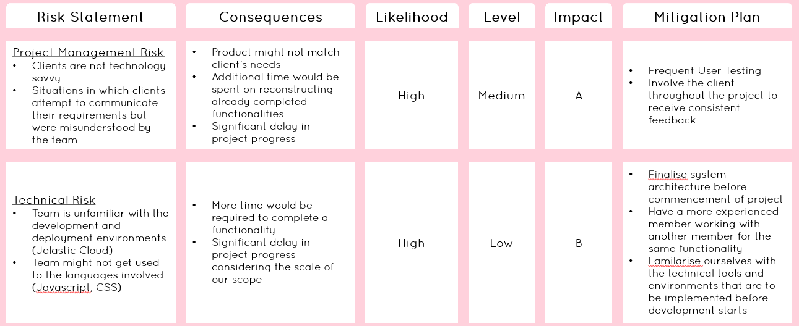
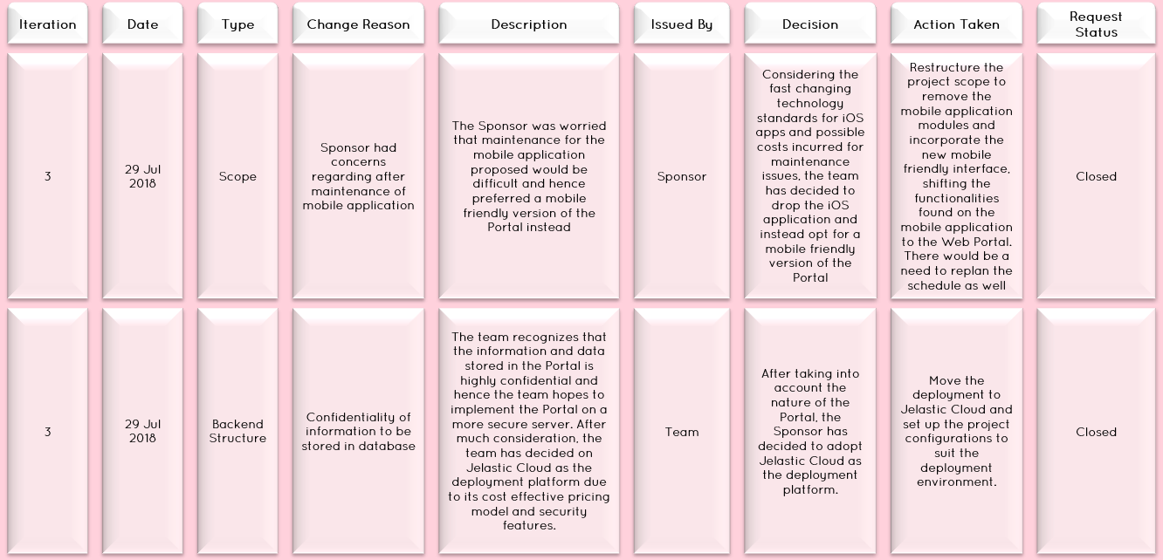
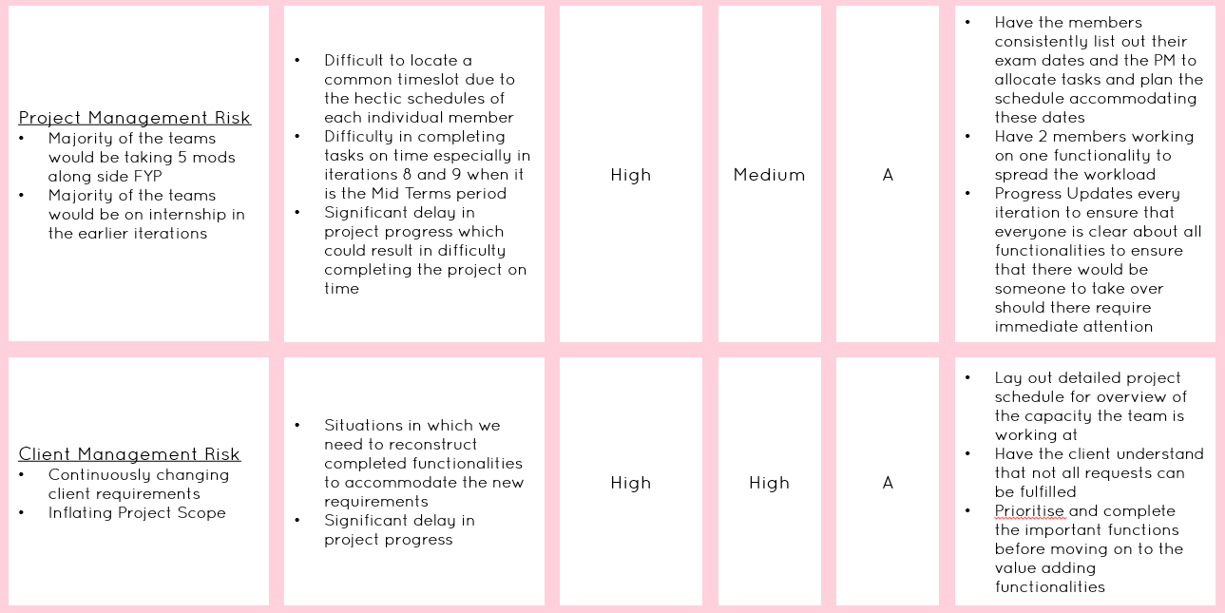
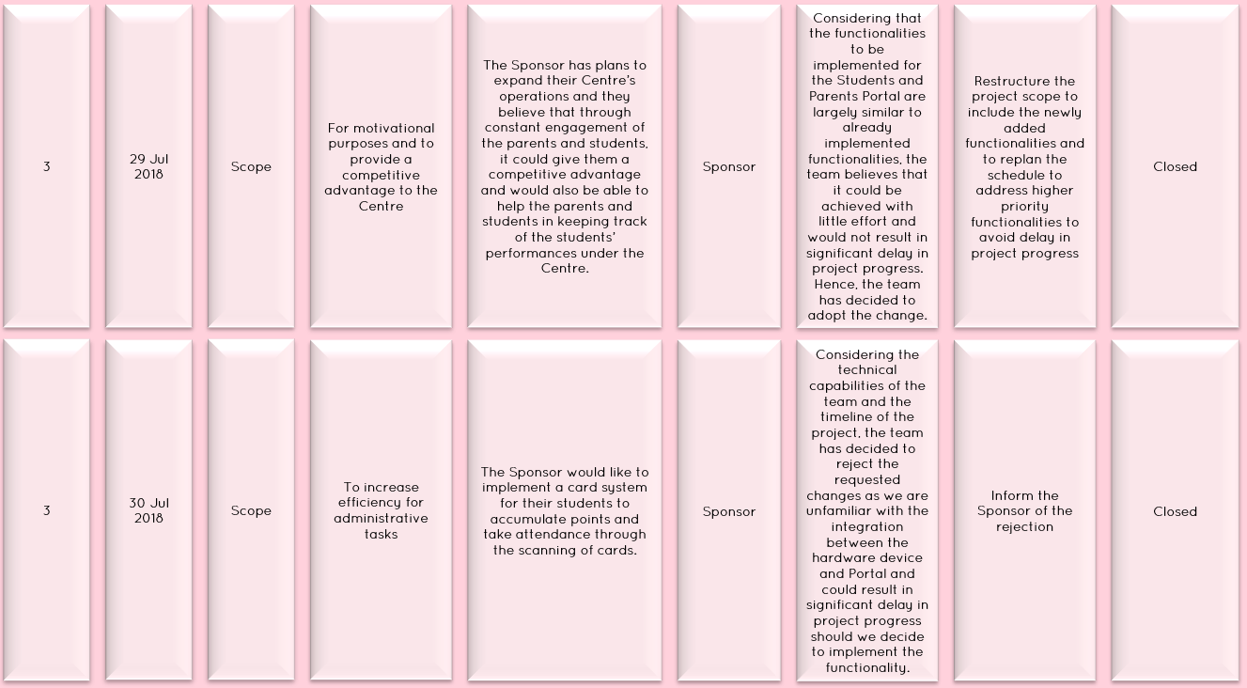
Project Risks
The Risk Management and Change Management approaches helps the team to overcome any potential challenges we face throughout the course of our project and aids us in completing the project on time. Click here to find out more regarding our risks and changes!

Slide 81
Intermediate Deliverables
Technical Complexity

Slide 82
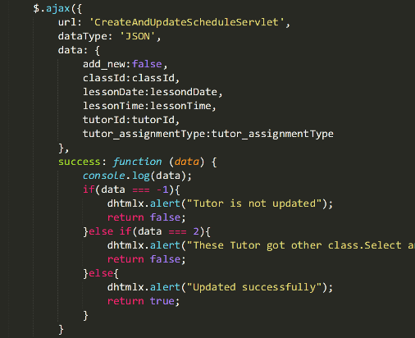
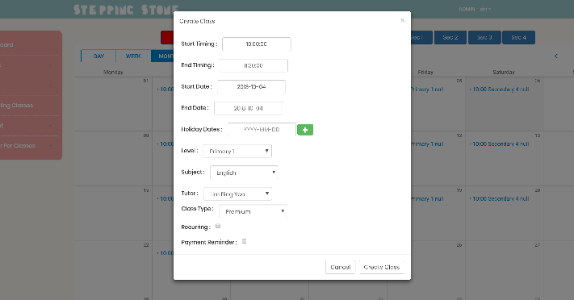
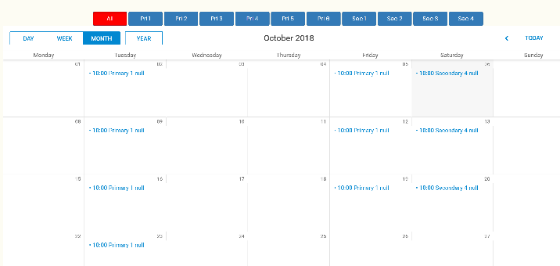
AJAX (Asynchronous JavaScript and XML)
While the team was developing the issue, the team realizes the lacking aspect in terms of user experiences as every time the page requires data, it would make a HTTP request and this results in constant refreshing of the web pages, making it very unpleasant for the users. Hence, the team actively sourced for ways in which we could complete the data retrieval without jeopardizing the user experiences. We decided on AJAX as the main communication tool between the front end and back end because it allows the page to load a specific section at an amazing speed without compromising the other pages. With AJAX, there is no longer need to reload an entire page just to retrieve and update the page with new information and hence reduces the load on the server.
However, the implementation of AJAX was particularly challenging for the team as it requires knowledge of the JavaScript language and majority of the members were not particularly familiar with the language itself.
Subject dynamically retrieved based on the level selected, implemented through AJAX
Lessons would be created and shown immediately on the calendar without the need to reload the entire page

Slide 83
DHTMLXScheduler
The team has chosen to utilize the DHTMLXScheduler library for our Scheduling module because of its extensive features and easy user interface which would serve the clients their best purpose.
However, upon researching on the library, the documentations were mainly on PHP and considering that our Scheduling module requires a lot of customisations, we were unable to utilize some of the in built functionalities that the library offers.
Hence, the team utilized a combination of the library with AJAX and Bootstrap to enjoy the extensive features that the library offers yet be able to customize certain functionalities to best fit our purposes.
Utilising Bootstrap with DHTMLXScheduler to provide a customized lightbox for the creation of classes
Implementing the creation of events to be reflected on the interface using AJAX

Slide 84
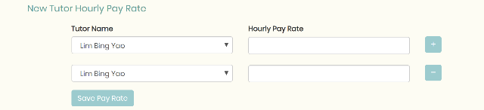
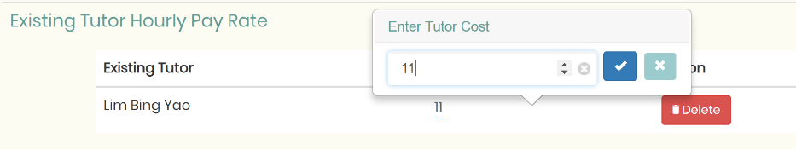
jQuery
The clients have specifically made requests for the interface to remain clean and easy for usage, meaning that the clients preferred a minimalist UI design. At the same time, the clients wishes to have attain flexibility in the functionalities.
However, the team faces a difficulty in that our knowledge of HTML language does not provide the clients with the flexibility that they wanted. After much research, the team has decided to focus bulk of our front end interface on utilizing jQuery for a more enhanced user experience.
As a result, majority of our front end designs utilizes jQuery in order to attain a minimalist design yet provide our clients with the flexibility that they want. Features such as dynamic row inserting. editable table fields and mass uploading allows the users to enter minimal inputs when not required, yet have the ability to include more information when there is a need to.
Dynamic Row Adding
Popup Editable Fields

Slide 85
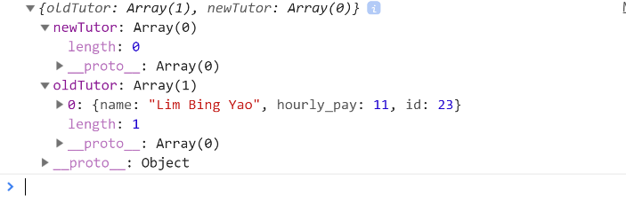
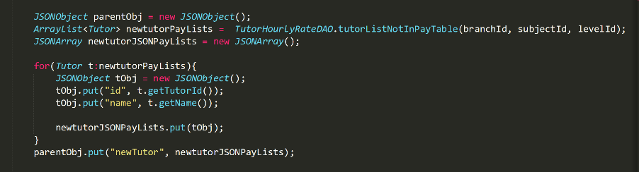
JSON
The team has chosen JSON to be the main form of data communication between front end and back end. The main reason being that JSON is lightweight and hence reduces the load on our server, allowing the pages to load at a faster pace, enhancing user experiences.
Font End JSON Output
Backend JSON Code

Slide 86
Learning Outcomes
With 5 mods including FYP as well as two sports competitions has made me very pressed for time. However, it better taught me how to manage and plan my time. It has also taught me how to better work in a team, not to overpromise deadlines for example.
Through this project I have also improved my coding proficiency and expanded my knowledge on languages.
-Shawn
The role of the Project Manager has made me realise my shortcomings with regards to time management and leadership. I recognized that there are times when the PM has to be firm with her decisions and there are times when the PM has to be flexible with her choices. For me, this ability to make the right call is being honed over the course of this project.
In addition, I am responsible for liaising with the clients and while I was communicating our ideas across to them, I realise the difficulty of expressing myself to them properly. As the time passes by, I got more used to explaining in a way that they could understand and hence I feel that this project has definitely honed my communication skills.
-Hui Xin

Slide 87
As the Lead Front End Developer, I was responsible for designing and implementing an interface that is comfortable for the users, especially considering that our clients are not for sophisticated designs but rather simplicity and practicality. While at times I might have felt that a particular implementation is better, the clients might have other thoughts and that was when I realized that I am not totally placing myself in their shoes. This was a valuable learning experience for me as a Front End Developer
-Moh Moh
As a Back End Developer, I work a lot with coding logic and technical implementations. Certain frameworks or libraries are foreign to me and I have to familarise myself with those technical tools in the shortest time possible due to our tight schedule. Hence, consistent learning throughout development and time management became my key takeaways from this project, aside from all the new technical knowledge.
-Deyu

Slide 88
I have gained experience in understanding and implementing the system based on client's requirement. Most importantly, I was able to learn from experience on working with clients and produce a system that is being use by a real clients.
Besides, as a member of the team, I hope to learn to work as a team, and gain knowledge from the rest of the team while I also share the knowledge I have.
-Riana
I have built on my critical-thinking capability. After meeting the clients, we need to understand client's current business problems so that we can propose solutions that fulfil their real needs.
I have also learnt the importance of planning. Especially when I was having internship which occupant most of my time. Hence the ability to plan properly to complete the tasks assigned to me was extremely important.
-Zang Yu

Slide 89
Pilot Testing
Branch Involved: Stepping Stones Learning Centre, Bukit
Panjang Branch
Period: 29 October 2018 – 27 November 2018
Participants: 3 Branch Admins, 4 Tutors, 61 Students and
17 Classes
Purpose: To evaluate feasibility, time, cost,
adverse events, and improve
upon the study design prior to
adopting the full Portal
Attendance Taking Module
Grades Module
Scheduling Module
Admin Module
Accounts Module

Slide 90
Feedbacks
Rectifications
Certain classes consists of students of varying levels (E.g Sec 3 and Sec 4 English classes are combined) but the scheduling functionality does not cater to this.
We would be relooking at our business logic in order to account for this special case and restructure our interface
Unable to edit attendance once marked
Added absent and present to edit again
Can’t enter additional detail field for student registration
Will be adding option fields and will only appear when the user want to add optional
Tutor Account Creation emails are sending out the wrong usernames
Have edited the information to be sent out in the email

